Slide 1


DATA WRANGLING & FEATURE ENGINEERING

Slide 2

Module Agenda
Overview of Business Financial Planning & Analysis Use Cases
Introduction to Data Wrangling & Feature Engineering
Pandas Library & ChatGPT Integration
Locating and handling missing datasets
Sorting and Filtering
Concatenation and Merging
Feature Engineering
One-hot-encoding
Standardization vs. Normalization
Practical Example 1: Data Wrangling and Analysis
Practical Example 2: Data Wrangling and Feature Engineering
Practice Opportunity
© All rights reserved for Dr. Ryan Ahmed @Stemplicity Inc.

Slide 3
INTRODUCTION TO FINANCIAL PLANNING AND ANALYSIS (FP&A)

Slide 4
Financial Planning and Analysis
Data Wrangling & Analysis: Automate reconciliation and analysis of financial data.
Competitor Analysis: Analyze competitors' financials and strategic positioning.
Anomaly Detection: Identify errors in financial transactions with AI.
Time series Forecasting: Predict financial performance using historical data and market trends.
Variance Analysis: Analyze actuals vs. budgets to pinpoint variances and corrective actions.
Scenario Planning: Model scenarios to evaluate business decisions' financial impacts.
Financial Narratives: Generate AI-driven insights for clear stakeholder communication.
Cost Optimization: Identify inefficiencies and recommend cost-saving measures.
Data Visualization: Visualize financial data for strategic decision making.
Financial Prediction Using ML Regression: Predict financial metrics such as revenues& expenses.
Financial Planning and Analysis (FP&A) is a critical business function that focuses on providing financial insights to support decision-making and drive a company’s strategic objectives.
It involves analyzing financial data, forecasting future financial performance, budgeting, and offering recommendations to enhance financial health and operational efficiency.
© All rights reserved for Dr. Ryan Ahmed @Stemplicity Inc.

Slide 5
INTRODUCTION TO DATA WRANGLING & ANALYSIS

Slide 6
Financial Planning and Analysis
Data Wrangling & Analysis: Automate reconciliation and analysis of financial data.
Competitor Analysis: Analyze competitors' financials and strategic positioning.
Anomaly Detection: Identify errors in financial transactions with AI.
Time series Forecasting: Predict financial performance using historical data and market trends.
Variance Analysis: Analyze actuals vs. budgets to pinpoint variances and corrective actions.
Scenario Planning: Model scenarios to evaluate business decisions' financial impacts.
Financial Narratives: Generate AI-driven insights for clear stakeholder communication.
Cost Optimization: Identify inefficiencies and recommend cost-saving measures.
Data Visualization: Visualize financial data for strategic decision making.
Financial Prediction Using ML Regression: Predict financial metrics such as revenues& expenses.
Financial Planning and Analysis (FP&A) is a critical business function that focuses on providing financial insights to support decision-making and drive a company’s strategic objectives.
It involves analyzing financial data, forecasting future financial performance, budgeting, and offering recommendations to enhance financial health and operational efficiency.
© All rights reserved for Dr. Ryan Ahmed @Stemplicity Inc.

Slide 7
Introduction to Data Wrangling & Feature Engineering
In this module, we will perform data wrangling and feature engineering on real-world datasets using Generative AI.
Real-world data is usually messy, unstructured, and rarely comes in a usable form.
Data scientists spend ~80% of their time performing data wrangling and feature engineering.
Data Wrangling
Involves cleaning and organizing raw datasets by merging multiple sources of data, handling missing values, and converting data from one format to another.
Feature Engineering
Involves transforming features to improve the performance of downstream AI models. It involves feature selection, scaling, and creating new features from existing ones.
© All rights reserved for Dr. Ryan Ahmed @Stemplicity Inc.

Slide 8
What’s wrong with this data?
CUSTOMER ID | CUSTOMER NAME | LOCATION | CLICK ON AD?
1 | Georgina | USA | Yes
2 | Leila | Canada | 1
3 | Sarah | France | 0
4 | Bird |  | 1
5 | Max | Netherlands | 0
6 | Sarah | France | 0
© All rights reserved for Dr. Ryan Ahmed @Stemplicity Inc.

Slide 9
What’s wrong with this data? Solution
ENTIRE COLUMN REQUIRES ENCODING
CUSTOMER ID | CUSTOMER NAME | LOCATION | CLICK ON AD?
1 | Georgina | USA | Yes
2 | Leila | Canada | 1
3 | Sarah | France | 0
4 | Bird |  | 1
5 | Max | Netherlands | 0
6 | Sarah | France | 0
REQUIRES FORMATTING
© All rights reserved for Dr. Ryan Ahmed @Stemplicity Inc.
DUPLICATE ENTRY
MISSING INFORMATION

Slide 10
PANDAS LIBRARY & CHATGPT INTEGRATION

Slide 11


What is Pandas?
Pandas is a powerful Python library for data analysis and manipulation, widely used in data science, machine learning, and analytics.
Why Use Pandas?
Simplifies working with large datasets.
Flexible and fast for complex operations.
Widely supported in Python's data science ecosystem.
© All rights reserved for Dr. Ryan Ahmed @Stemplicity Inc.

Slide 12
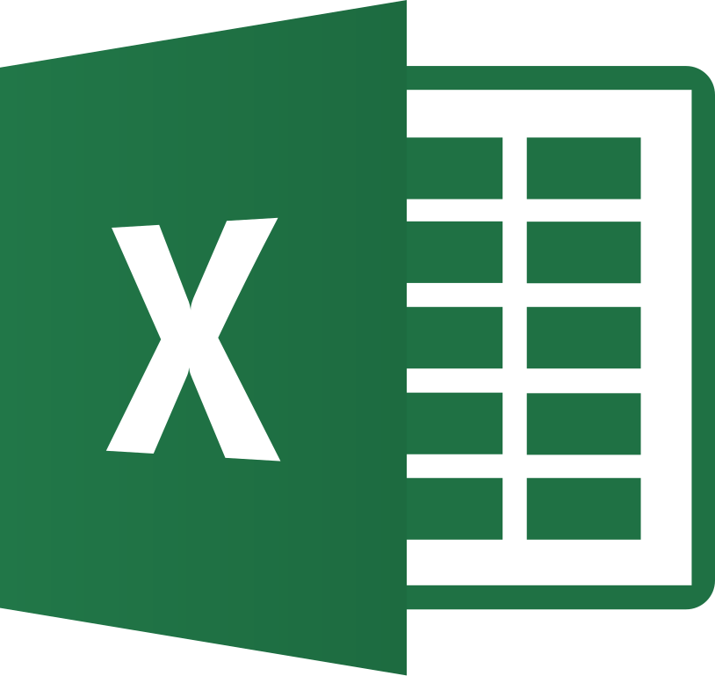
Pandas Vs. Excel
Feature | Excel | Pandas
Platform | GUI-based spreadsheet application | Python-based programming library
Data Size | Limited by Excel's rows/columns limits | Handles large datasets efficiently
Automation | Requires manual effort or VBA macros | Fully scriptable with Python
Speed | Slower for large datasets or calculations | Fast with optimized operations
Reproducibility | Manual steps; hard to document | Code-driven; easy to reproduce results
Complex Analysis | Limited advanced tools | Built-in advanced data manipulation
Integration | Limited to Excel-supported formats | Supports many formats (CSV, SQL, JSON)
Visualization | Built-in charting tools | Integrates with Matplotlib/Seaborn
© All rights reserved for Dr. Ryan Ahmed @Stemplicity Inc.

Slide 13
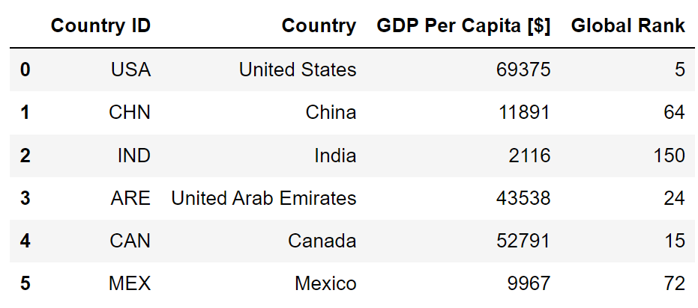
Pandas DataFrames
Pandas DataFrame is a 2-dimensional, tabular data structure in the Python library Pandas.
It is like a spreadsheet or SQL table and is the most used tool in data analysis & manipulation.
Column Names
Data
Index/Label
© All rights reserved for Dr. Ryan Ahmed @Stemplicity Inc.

Slide 14
Pandas DataFrames Features
Heterogeneous: Columns store different data types (e.g., numbers, strings, dates).
Powerful Operations: Enables filtering, aggregation, & analysis.
Tabular Format: Organized into rows (index) and columns (labels), like a spreadsheet.
Data Sources: Supports input from CSV, Excel, SQL.
Labeled Indexing: Access data easily using labels or positions.
© All rights reserved for Dr. Ryan Ahmed @Stemplicity Inc.

Slide 15
PRACTICAL EXAMPLE 1: DATA WRANGLING & ANALYSIS IN PANDAS

Slide 16
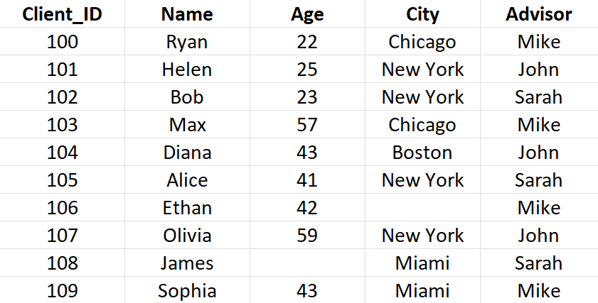
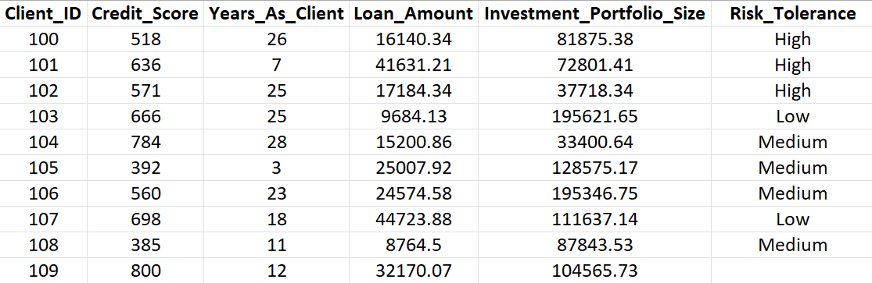
Practical Example
The objective of this case study is to perform data wrangling and analysis on client data.
The data is contained in two different tables, namely: “Client_Demographics.xlsx” and “Client_Financial_Details.xlsx”.
Client_Demographics.xlsx
Client_Financial_Details.xlsx
© All rights reserved for Dr. Ryan Ahmed @Stemplicity Inc.
Click here to access the Jupyter Notebook.

Slide 17
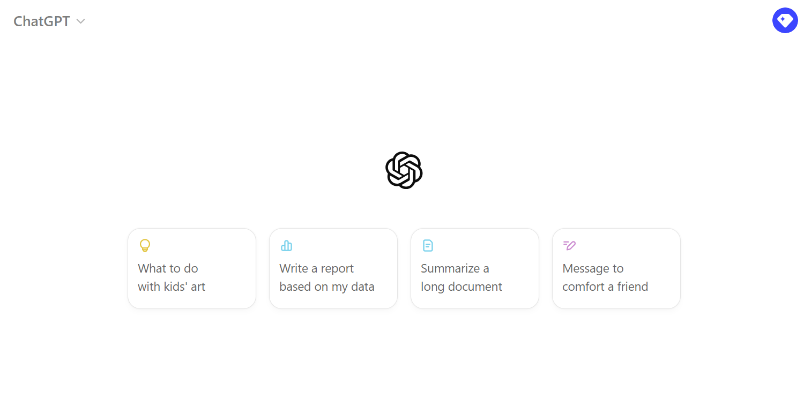
Practical Example
🔗 Click here to explore ChatGPT ChatGPT Signup
💡 Click here for AI Prompts Explore Prompts
© All rights reserved for Dr. Ryan Ahmed @Stemplicity Inc.

Slide 18
Using pd.read_excel( ) to Load Excel Files into Pandas
Pandas pd.read_excel( ) method is used to read data from Excel files into a Pandas DataFrame.
This allows you to manipulate and analyze Excel data programmatically in Python.
© All rights reserved for Dr. Ryan Ahmed @Stemplicity Inc.
df_demographics = pd.read_excel('Client_Demographics.xlsx')
DataFrame to Store Results
Function Name
Name of the Excel File

Slide 19
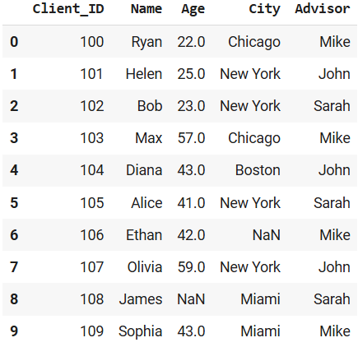
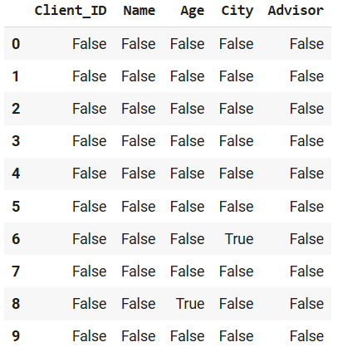
Locate Missing Data using .isnull( ) Method
The “.isnull()” method is used to locate missing values in Pandas DataFrames.
It works by returning another DataFrame containing “True” in missing values location and “False” otherwise.
Returns “True” in Missing Locations
Missing Data
DataFrame Name
© All rights reserved for Dr. Ryan Ahmed @Stemplicity Inc.
Method
df_demographics.isnull( )
Locate Cells Containing Missing Values

Slide 20
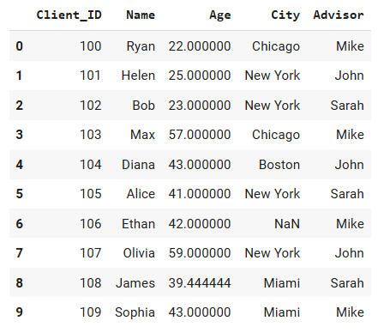
Handling Missing Data using .fillna( ) Method
The “.fillna()” method is used to replace missing values with a specific value (mean, median,..).
Mean Value
Missing Data
© All rights reserved for Dr. Ryan Ahmed @Stemplicity Inc.
DataFrame Column You Want to Fix
New Value Replacing Missing Ones
Method Name
df_demographics['Age'] = df_demographics['Age'].fillna(df_demographics['Age'].mean())

Slide 21
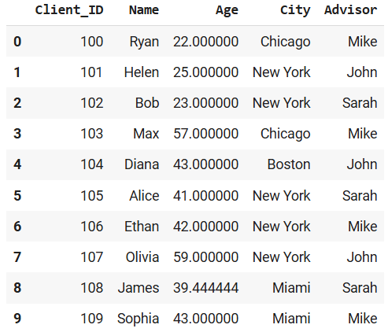
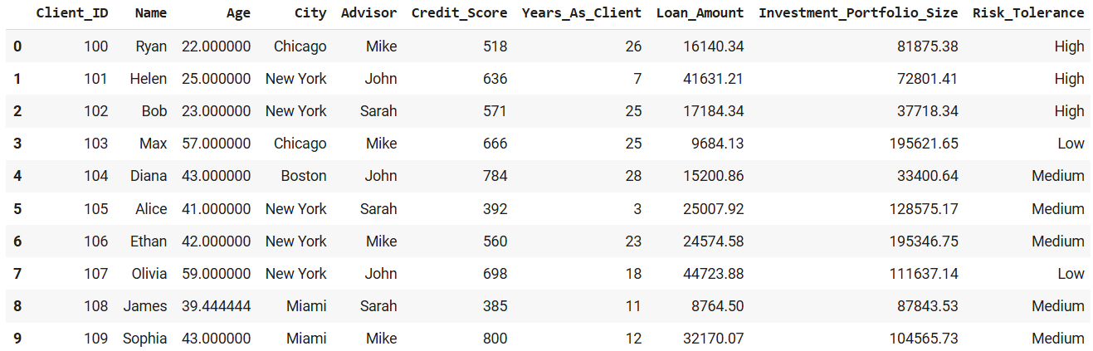
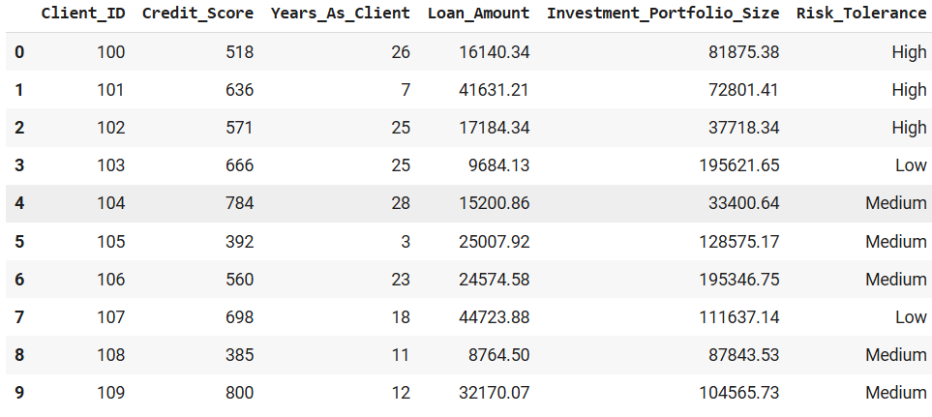
Merging Pandas DataFrames Using pd.merge( ) Method
Pandas “merge( )” method merges two DataFrames on a given axis.
“df_demographics”
Merged DataFrame “df_clients_combined”
Merging Operation
© All rights reserved for Dr. Ryan Ahmed @Stemplicity Inc.
“df_financials”
df_clients_combined = pd.merge(df_demographics, df_financials, on = 'Client_ID', how = 'left')
Merged DataFrame
Merge Method
DataFrames that Need to be Merged
DataFrame column to merge on
Merge Type

Slide 22



Popular Data Visualization Libraries
Python offers many libraries for data visualization such as Matplotlib, Seaborn, and Plotly.
Grandfather of data visualization libraries.
It creates static & interactive visualizations.
Link: https://matplotlib.org/
Based on Matplotlib & offers enhanced features.
Generates aesthetically appealing statistical plots.
Link: https://seaborn.pydata.org/
Plotly creates interactive charts using a few code lines.
Offers 40+ chart types (statistical, financial & scientific).
Link: https://plotly.com/python/
© All rights reserved for Dr. Ryan Ahmed @Stemplicity Inc.

Slide 23
FEATURE ENGINEERING

Slide 24
Feature Engineering Techniques
Imputation
Handling Outliers
Binning
Log Transform
One-Hot Encoding
Feature Split
Scaling
© All rights reserved for Dr. Ryan Ahmed @Stemplicity Inc.

Slide 25
One-Hot-Encoding
One-hot-encoding works by converting values such as “color” into columns with 1’s and 0’s.
Since machine learning models deal with numbers, we perform one-hot-encoding to convert categorical data into numerical.
COLOR
RED
RED
YELLOW
GREEN
YELLOW
RED | YELLOW | GREEN
1 | 0 | 0
1 | 0 | 0
0 | 1 | 0
0 | 0 | 1
0 | 1 | 0
© All rights reserved for Dr. Ryan Ahmed @Stemplicity Inc.

Slide 26
One-hot-Encoding: Important Note
Can we simply replace colours with integer values? No!
The machine learning model will assume that:
$$GREEN>YELLOW>RED$$
WRONG!
COLOR
RED
RED
YELLOW
GREEN
YELLOW
ENCODED COLOR
1
1
2
3
2
© All rights reserved for Dr. Ryan Ahmed @Stemplicity Inc.

Slide 27
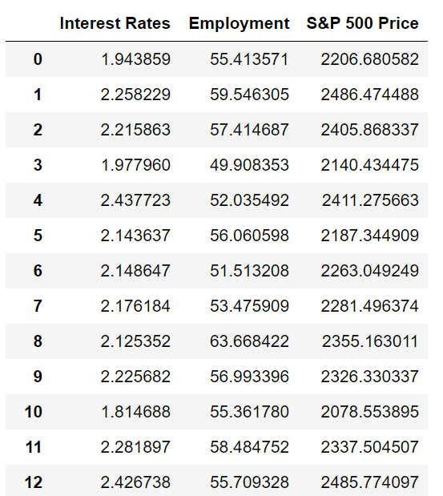
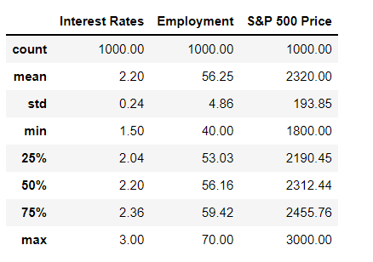
Feature Scaling
Feature Scaling is an important step to take before training machine learning models to ensure that features are within the same scale.
Example: The interest rate and employment score are on different scales. This will result in one feature dominating the other.
RAW ORIGINAL DATASET
QUICK STATS!
© All rights reserved for Dr. Ryan Ahmed @Stemplicity Inc.

Slide 28
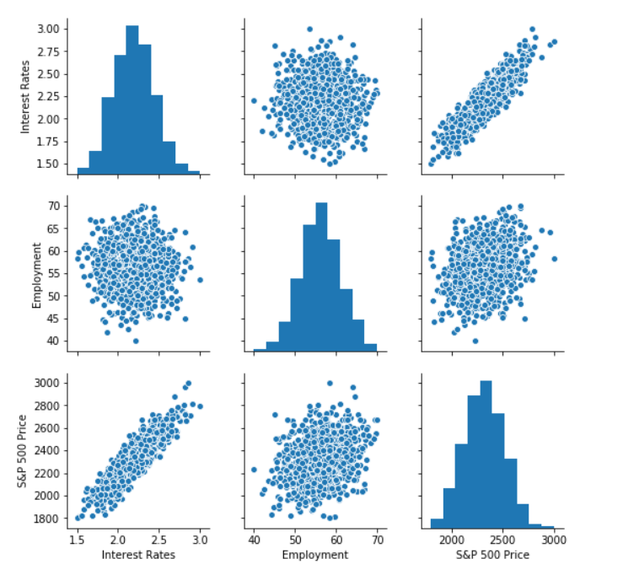
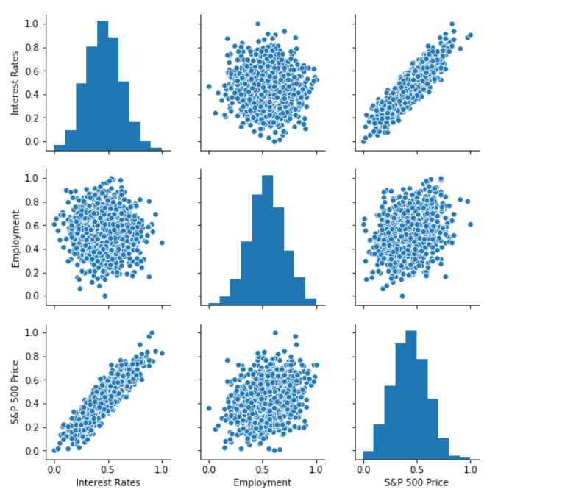
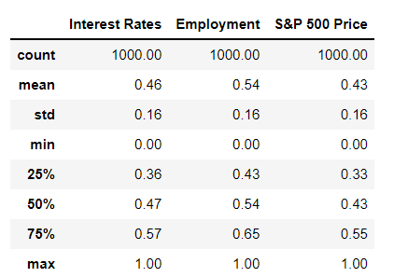
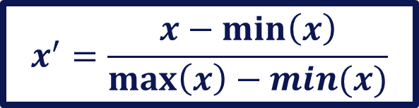
Normalization
Normalization is conducted to make feature values range from 0 to 1.
$$x^{′}=\frac{x−\min\left(x\right)}{\max\left(x\right)−min⁡(x)}$$
© All rights reserved for Dr. Ryan Ahmed @Stemplicity Inc.

Slide 29
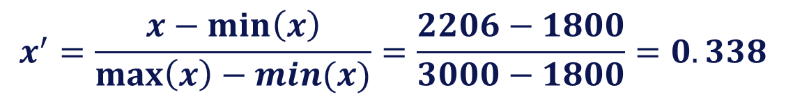
Normalization Example
$$x^{′}=\frac{x−\min\left(x\right)}{\max\left(x\right)−min⁡(x)}=\frac{2206−1800}{3000−1800}=0.338$$
S&P 500 PRICE (ORIGINAL)
2206
2319
3000
1800
S&P 500 PRICE (NORMALIZED)
0.338
0.432
1
0
Normalization
Note That Numbers Now Range From 0 To 1 After Normalization
Randomly selected Value
Average
© All rights reserved for Dr. Ryan Ahmed @Stemplicity Inc.
S&P 500 PRICE (Max) = 3000
S&P 500 PRICE (Min) = 1800
Maximum
Minimum

Slide 30
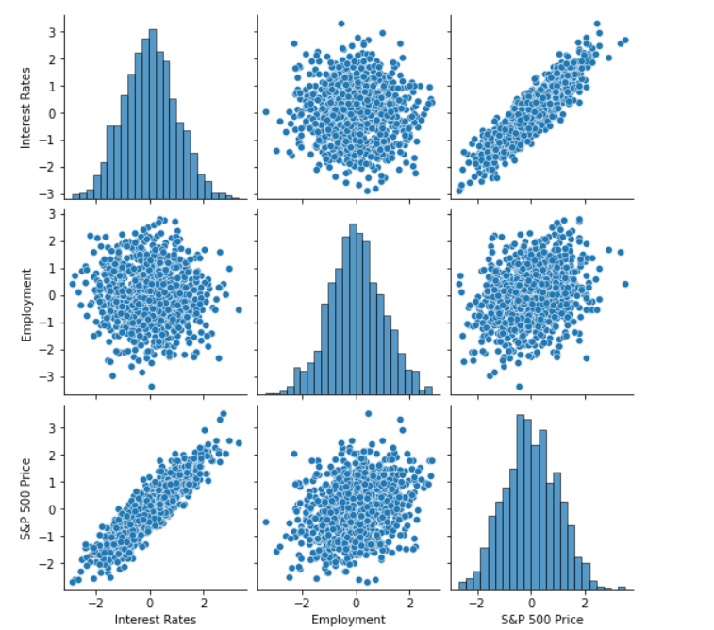
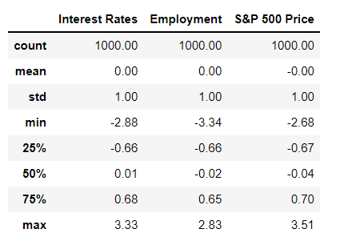
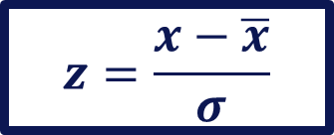
Standardization
Standardization is conducted to transform the data with a mean of zero and a standard deviation of 1.
$$z=\frac{x−\overline{x}}{σ}$$
© All rights reserved for Dr. Ryan Ahmed @Stemplicity Inc.

Slide 31
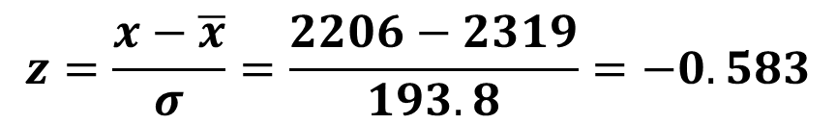
Standardization Example
$$z=\frac{x−\overline{x}}{σ}=\frac{2206−2319}{193.8}=−0.583$$
S&P 500 PRICE (ORIGINAL)
2206
2319
3000
1800
S&P 500 PRICE (STANDARIZED)
-0.583
0
3.513
-2.67
Note That After Standardization, the Average Is Set To Zero
Randomly selected Value
Standardization
Average
© All rights reserved for Dr. Ryan Ahmed @Stemplicity Inc.
Maximum
S&P 500 PRICE (Mean) = 2319
S&P 500 PRICE (Std) = 193.8
Minimum
“A normalized dataset will always range from 0 to 1”
“A standardized dataset will always have a mean of 0 and standard deviation of 1, but can have any upper and lower values”

Slide 32
PRACTICAL EXAMPLE 2: DATA WRANGLING & FEATURE ENGINEERING

Slide 33
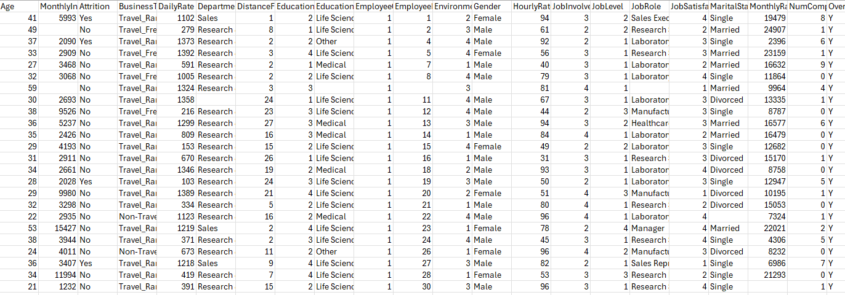
Practical Example
The objective of this case study is to perform data wrangling and feature engineering on human resources data.
© All rights reserved for Dr. Ryan Ahmed @Stemplicity Inc.

Slide 34
Practical Example
🔗 Click here to explore ChatGPT ChatGPT Signup
💡 Click here for AI Prompts Explore Prompts
© All rights reserved for Dr. Ryan Ahmed @Stemplicity Inc.

Slide 35
PRACTICE OPPORTUNITY

Slide 36
Practice Opportunity
Using Walmart datasets contained in “Walmart_sales_data.csv” that contains the following columns:
Transaction_ID: Unique identifier for each transaction.
Date: Transaction date.
Store_Location: The location of the store where the transaction took place.
Department: The department associated with the product.
Product_Name: The name of the product sold.
Quantity_Sold: Number of units sold.
Unit_Price: Price per unit of the product.
Total_Sales: Total sales amount before any discounts.
Discount_Percentage: Discount applied in percentage.
Discounted_Sales: Total sales after applying the discount.
Customer_Segment: Segment of the customer (e.g., Renovation Enthusiast, Pro Contractor).
Inventory_Level: Inventory available for the product.
Restock_Days: Estimated days until restock.
© All rights reserved for Dr. Ryan Ahmed @Stemplicity Inc.

Slide 37
Practice Opportunity
Perform the following tasks:
Locate missing values and perform data imputations. Explore two methods.
Provide a statistical summary of the Pandas Dataframe
Provide an overview of total sales by department and by location. Visualize the data using a bar chart.
Obtain standardization and normalization on the sales column. Perform a sanity check on the data.
Examine the most expensive product and transaction.
One-hot Encoding: Encode categorical variables like Store_Location. Check the code and perform a sanity check.
© All rights reserved for Dr. Ryan Ahmed @Stemplicity Inc.

Slide 38
Practice Opportunity Solutions
🔗 Click here to explore ChatGPT ChatGPT Signup
💡 Click here for AI Prompts Explore Prompts
💡 Click here for Practice Opportunities Solution Explore Prompts
© All rights reserved for Dr. Ryan Ahmed @Stemplicity Inc.

Slide 39
Thank you!

